Slide 1
TechTrek Web
Цифровая адаптация настольной игры по созданию стартапа
Выполнили: команда 4 (ск #1), группы 4 & 6

Slide 2






Александр Черных
Семен Шишкин
Филипп Штоколов
PM, BA, Team-lead
Fullstack Developer, QA
Fullstack Developer, QA
Полина Шапиро
Николай Меньшиков
Роман Родионов
2/31
UI&UX Designer
ML–developer
Fullstack Developer, QA
Notes:
So let's start off with a little bit more about me - I'm a developer advocate at Figma In my career I've put on multiple hats as a business analyst, an amateur designer, and as an iOS and Web Engineer At Figma, I use what I've learned to help bridge the gap between design and development for the teams that we talk to

Slide 3
TechTrek Web — это адаптивная бизнес-игра с ИИ, которая имитирует реальные условия и помогает пользователям развивать предпринимательские навыки без финансовых рисков.
3/31
Notes:
We're constantly hearing from teams looking to optimize their Product, Design, and Engineer processes One of the areas we hear about most is streamlining the design to development workflow how can they bridge the gap from design to code and do it with less pain

Slide 4
Какие проблемы
на рынке есть сейчас?
→
Сложно зайти с нуля в предпринимательство
→
Не хватает практического опыта
→
Нет персонализированного обучения или оно дорогое
→
Сложность в тестировании бизнес-идей
4/31
Notes:
one of the things we hear most often from development teams, are that designs are missing key details resulting in extra cycles this could be as minor as figuring out what's ready to build among a sea of designs and explorations or things like missing edge cases or responsive considerations

Slide 5

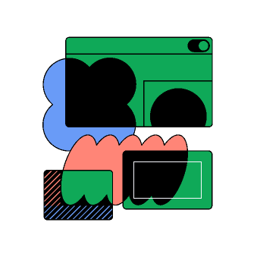

Что придумали мы?
Бизнес-игра
D&D
ML
5/31
Notes:
so we're going to talk about a few focus areas today we're going to talk about how to deal with ambiguous design specs establishing a shared language between designers and developers and opportunities to automate to make your process smoother

Slide 6
Совместив все это, мы получили...
Все как в реальном стартапе
D&D-механики
Game Master — AI
Игрок запускает стартап, изучает рынок и конкурентов, сталкивается с кризисами и возможностями, а в финале презентует проект инвесторам.
Игровой ход - интеллектуальный вызов для игрока, где бросок кубиков привносит элемент случайного фактора влияния
GM — это LLM-модель, которая создает кризисы, возможности и оценивает жизнеспособность стартапа.
6/31
Notes:
figma has robust extensibility APIs to help you set your team up for success including a plugin api, REST API, and Code Connect here are a few use cases that you can approach with these APIs syncing design tokens improving design workflows Efficiently surfacing design system details in a design

Slide 7

Целевая аудитория
Молодые предприниматели (18-24 года)
6 %
Студенты вузов (IT, экономика)
74.6 %
7/31
Notes:
So what is exactly is that pain? Traditionally, at most companies - teams go through a process like this Designers create a design, share a spec with the developer, and a developer builds those designs and wa-la you shipped your product It's typically viewed as a linear process, but the trouble is, it never quite works like that

Slide 8
Инсайты исследования
Популярны: ролевые механики, сюжет, прокачка, стратегии, кооператив
Интерес к бизнес-играм и управлению ресурсами
>50% задумывались о запуске стартапа
Запрос на знание основ бизнеса, но нехватка времени и средств
8/31
Notes:
so how can we solve for this?

Slide 9
Какие проблемы мы решаем
9/31
Notes:
these things are crucial details and cause delays in development developers are blocked until further details are added - or they might have to guess leading to changes that aren't accounted for in the design and suboptimal experiences for users for teams that are distributed or working across timezones, this effect is magnified even further and you could be waiting a while for the situation to be resolved

Slide 10
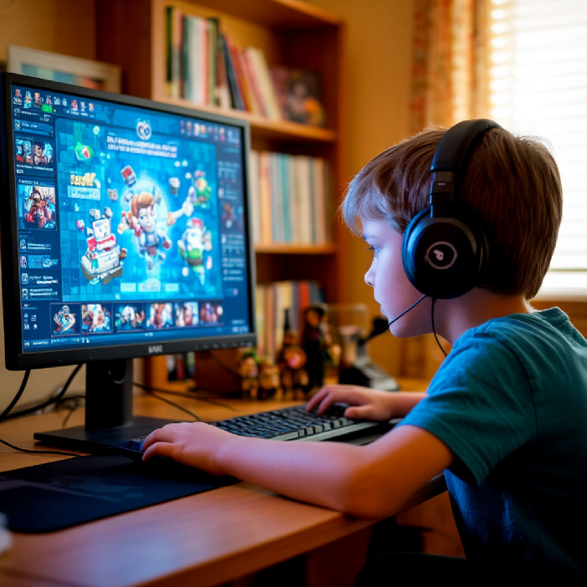
Обучение через игру
10/31
Notes:
these things are crucial details and cause delays in development developers are blocked until further details are added - or they might have to guess leading to changes that aren't accounted for in the design and suboptimal experiences for users for teams that are distributed or working across timezones, this effect is magnified even further and you could be waiting a while for the situation to be resolved

Slide 11
Fintech
E-commecrce
Сценарии для разных сфер стартапов
Agrotech
Gametech . &&&&&&&&&&
11/31
Notes:
one thing that we've seen with teams that excel at this, is that they establish a shared definition for ready for dev this will look different across teams as you each have different concerns - but it allows you to set up an expectation for design for what key details ALWAYS need to be considered before sharing a design with developers for example, does the design take into account responsive breakpoints does it cover example edge cases, like missing internet connection, errors from the backend is the design using components from the design system when possible and are design tokens being used when possible by standardizing your definition of ready for dev ahead of time, teams can make sure they have all the key details needed for building ahead of time this will help prevent blocks and reduce the cycles of back and forth that you'd have to go through in the building process

Slide 12
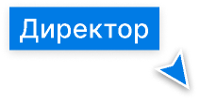
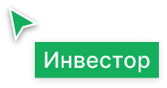
Тестирование и развитие идей с обратной связью
12/31
Notes:
one way is to bring developer input earlier in the design process if you're only getting invited into the design when things are ready to be built, ask to be invited earlier You can help designers uncover their blindspots when creating designs

Slide 13





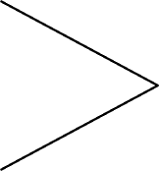
Аналитика каждой игры и разбор решений от ИИ
13/31
Notes:
Tooling helps but communication and collaboration are key to a better process

Slide 14
Анализ конкурентов
14/31
Notes:
so how can Figma help?

Slide 15
Критерий | Стартап-конструктор (Банда умников) | Симулятор IT-стартапа (SberCloud) | Virtonomica | Мы (TechTrek Web)
Выбор идеи стартапа | ⚠️ Без проработки | ⚠️ Только IT-сфера | ✅ Есть | ✅ Есть
Игровая механика | ✅ Придумывание идеи + комментарии | ⚠️ Выбор из 2-х вариантов | ⚠️ Развитие стартапа через “ферму” | ✅ Полноценная бизнес-симуляция
Обратная связь | ⚠️ Долго ждать фидбэк от игроков | ❌ Нет | ❌ Нет | ✅ ИИ анализирует решения игрока
Кризисные ситуации | ❌ Нет | ✅ Есть | ⚠️ Цикличные задания | ✅ Динамические вызовы
Этап презентации | ❌ Нет | ❌ Нет | ❌ Нет | ✅ Есть защита идей
Глубокий разбор решений | ❌ Нет | ❌ Нет | ❌ Нет | ✅ Анализ и комментарии от ИИ
Адаптивность под игрока | ❌ Нет | ❌ Нет | ❌ Нет | ✅ ИИ подстраивает сценарии под игрока
Монетизация | ❌ Нет | ❌ Нет | ❌ Нет | ❌ Нет. Но планируем!
Notes:
Let's start with ambiguous design specs

Slide 16





Стек технологий
Spring
React
PostgreSQL
Docker
Qwen 2.5
16/31
Notes:
So Some things to remember Share developer input early in the design process You can help design uncover their blind spots when it comes to development and set yourself up for success Align on shared language for developers and designers designers and developers have the same goal, to build a great product Leverage the power of extensibility

Slide 17
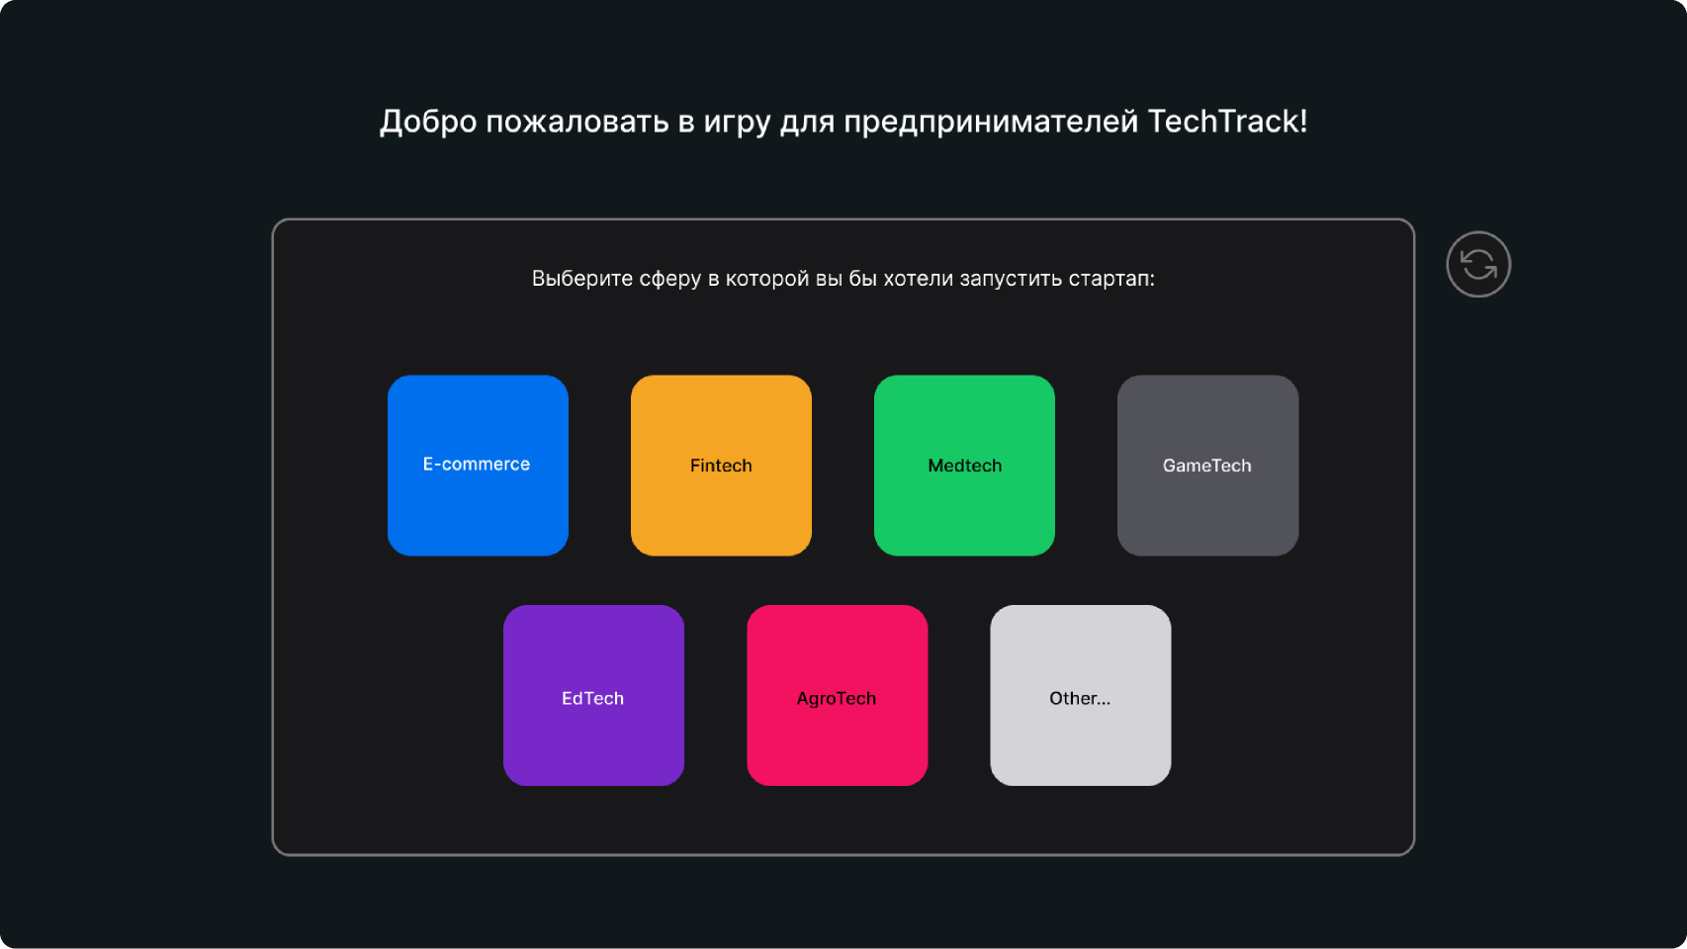
Прототипы
Старт
Выбор разнообразных сфер
17/31
Notes:
well with Dev Mode, we've made it easier for developers to be involved by being in the file, developers can leave feedback on designs directly and in context designers can also use dev mode features to organize and highlight details for handoff

Slide 18
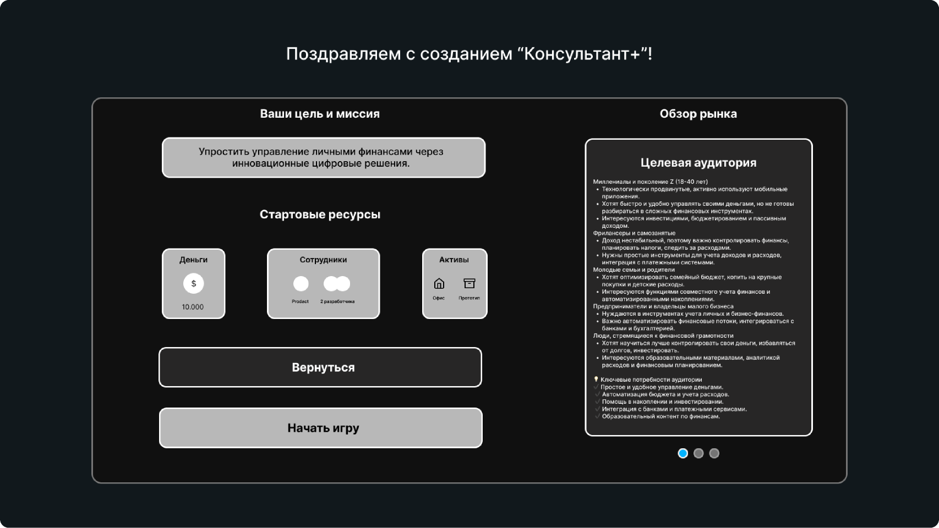
Прототипы
Старт
Ресурсы, обзоры рынка, конкуренты, тренды
18/31
Notes:
well with Dev Mode, we've made it easier for developers to be involved by being in the file, developers can leave feedback on designs directly and in context designers can also use dev mode features to organize and highlight details for handoff

Slide 19
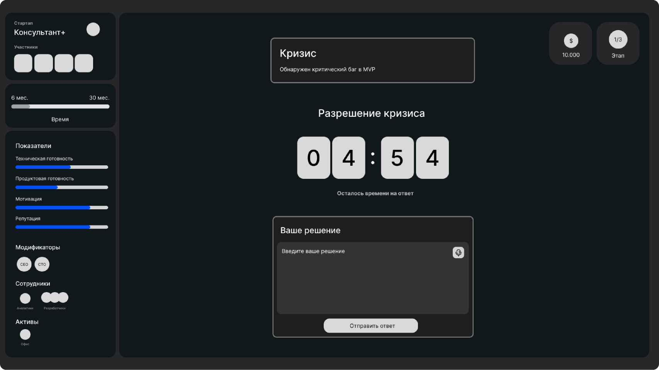
Прототипы
Игровой
ход
Разрешение кризисов
19/31
Notes:
well with Dev Mode, we've made it easier for developers to be involved by being in the file, developers can leave feedback on designs directly and in context designers can also use dev mode features to organize and highlight details for handoff

Slide 20
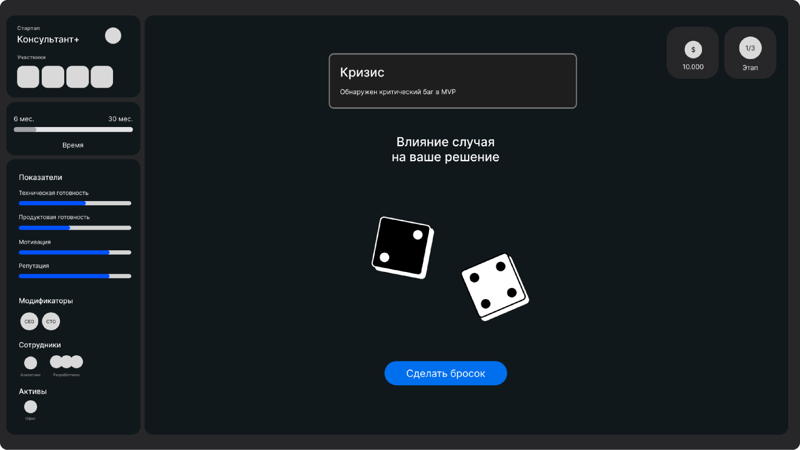
Прототипы
Игровой
ход
Элемент случайности
20/31
Notes:
well with Dev Mode, we've made it easier for developers to be involved by being in the file, developers can leave feedback on designs directly and in context designers can also use dev mode features to organize and highlight details for handoff

Slide 21
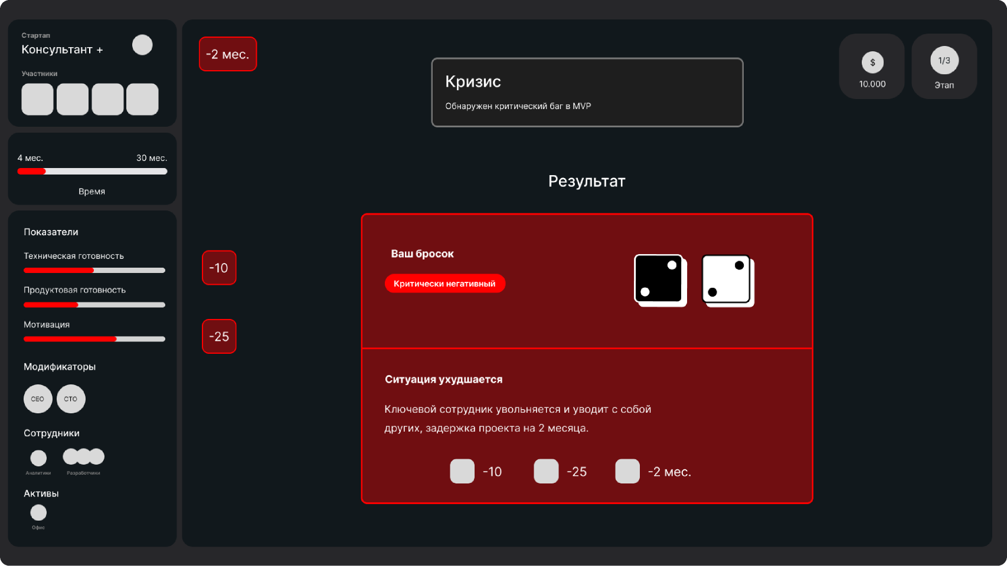
Прототипы
Игровой
ход
Влияние на ход игры
21/31
Notes:
well with Dev Mode, we've made it easier for developers to be involved by being in the file, developers can leave feedback on designs directly and in context designers can also use dev mode features to organize and highlight details for handoff

Slide 22
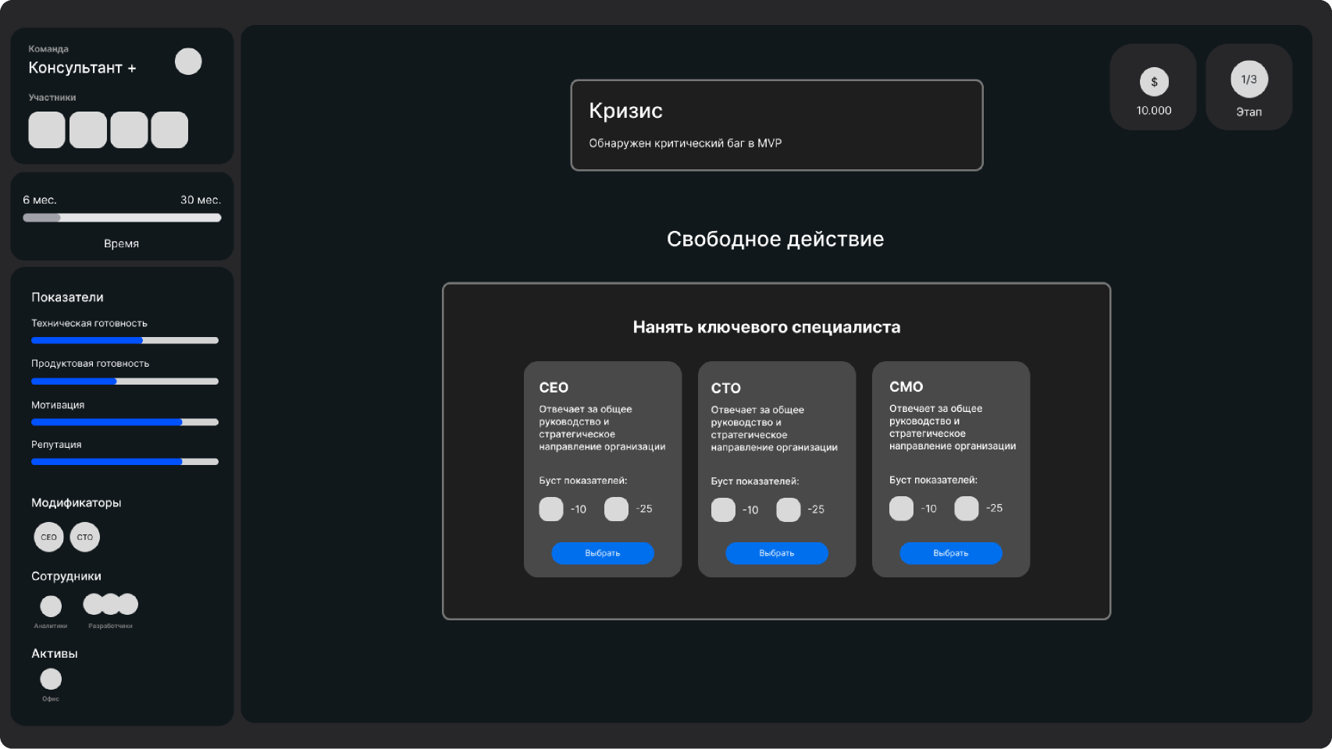
Прототипы
Свобода
хода
И возможность
решить возникший кризис
22/31
Notes:
well with Dev Mode, we've made it easier for developers to be involved by being in the file, developers can leave feedback on designs directly and in context designers can also use dev mode features to organize and highlight details for handoff

Slide 23
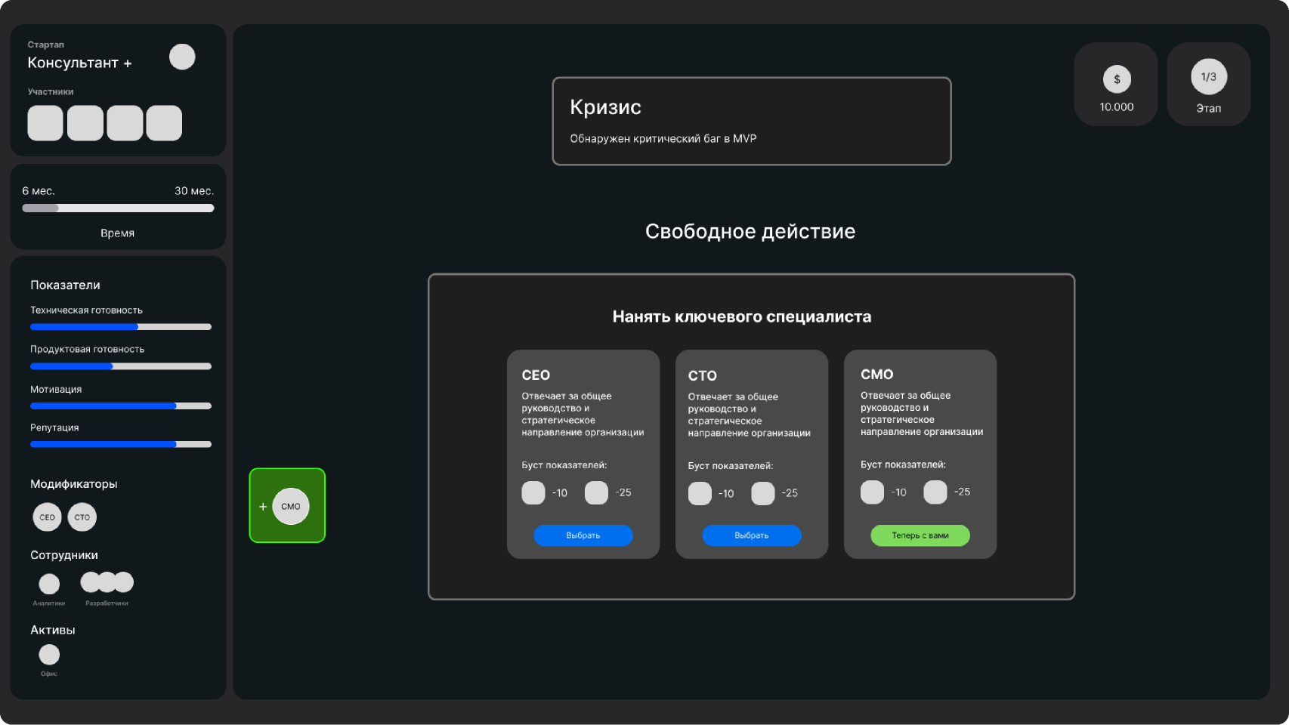
Прототипы
Свобода
хода
И возможность
решить возникший кризис
23/31
Notes:
well with Dev Mode, we've made it easier for developers to be involved by being in the file, developers can leave feedback on designs directly and in context designers can also use dev mode features to organize and highlight details for handoff

Slide 24
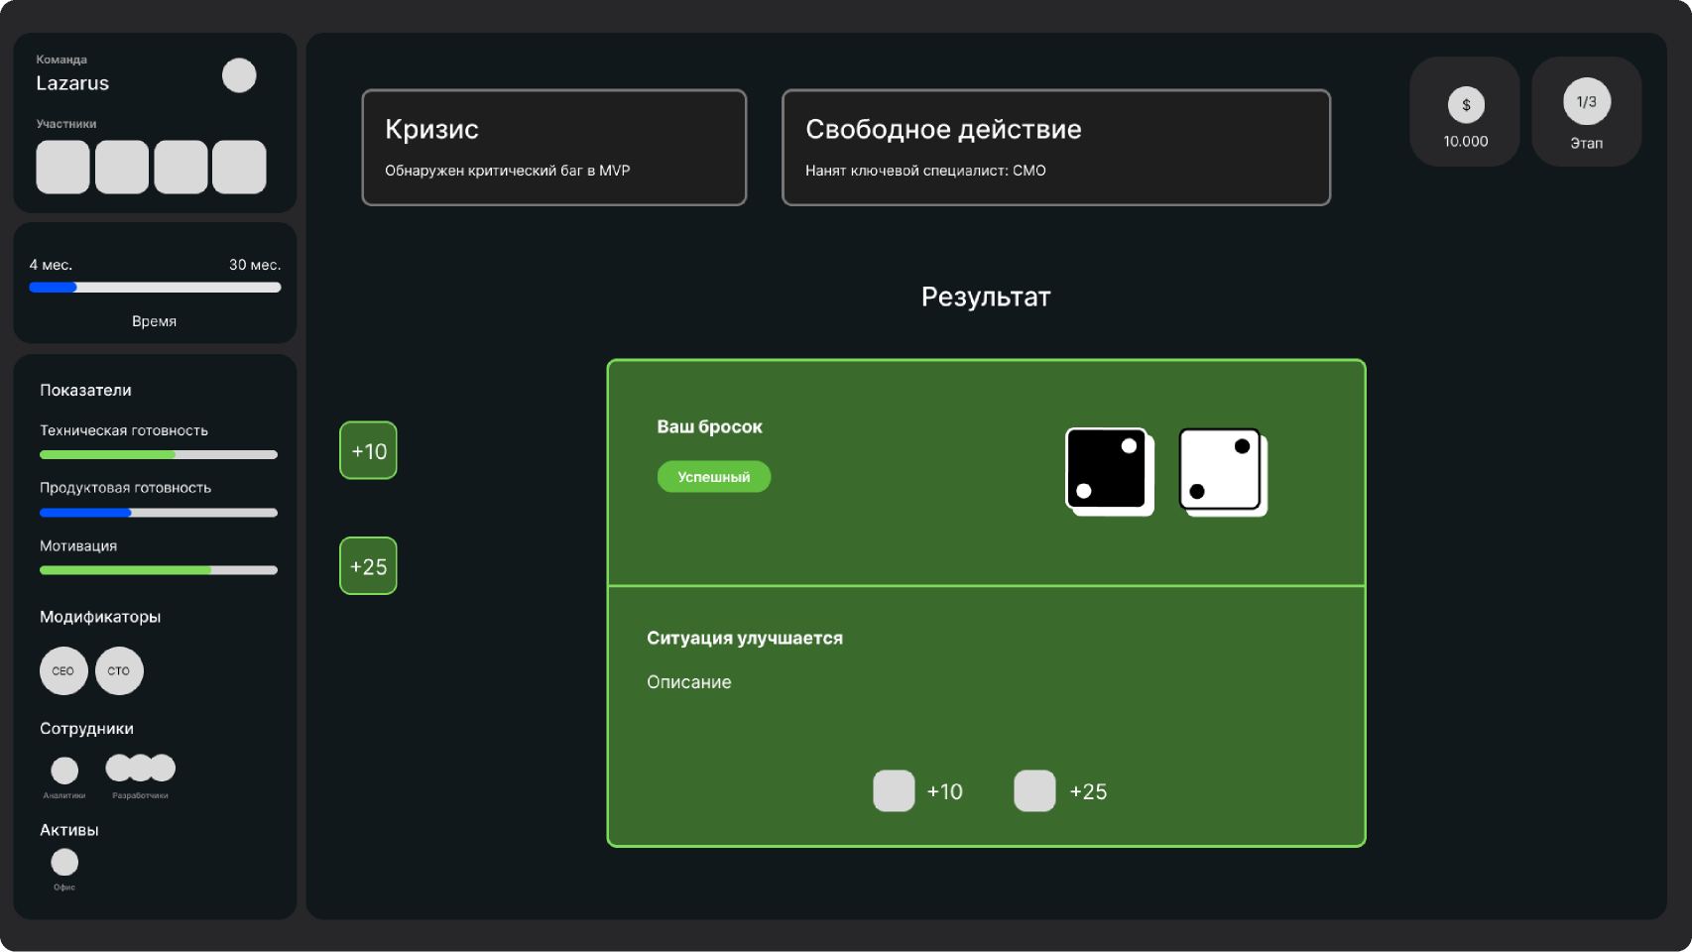
Прототипы
Свобода
хода
И возможность
решить возникший кризис
24/31
Notes:
well with Dev Mode, we've made it easier for developers to be involved by being in the file, developers can leave feedback on designs directly and in context designers can also use dev mode features to organize and highlight details for handoff

Slide 25
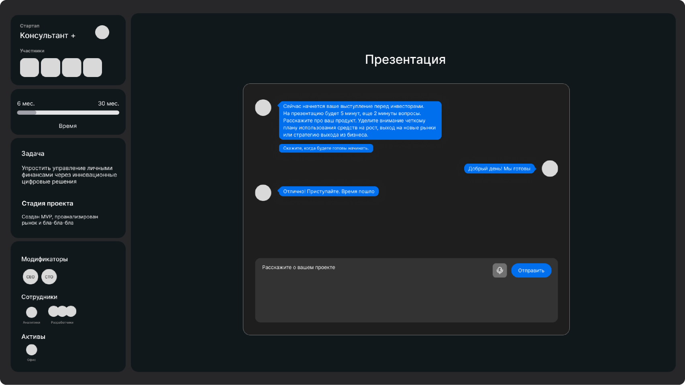
Прототипы
Защита
перед
инвесто-рами
AI-GM имитирует переговоры с реальными инвесторами
25/31
Notes:
well with Dev Mode, we've made it easier for developers to be involved by being in the file, developers can leave feedback on designs directly and in context designers can also use dev mode features to organize and highlight details for handoff

Slide 26
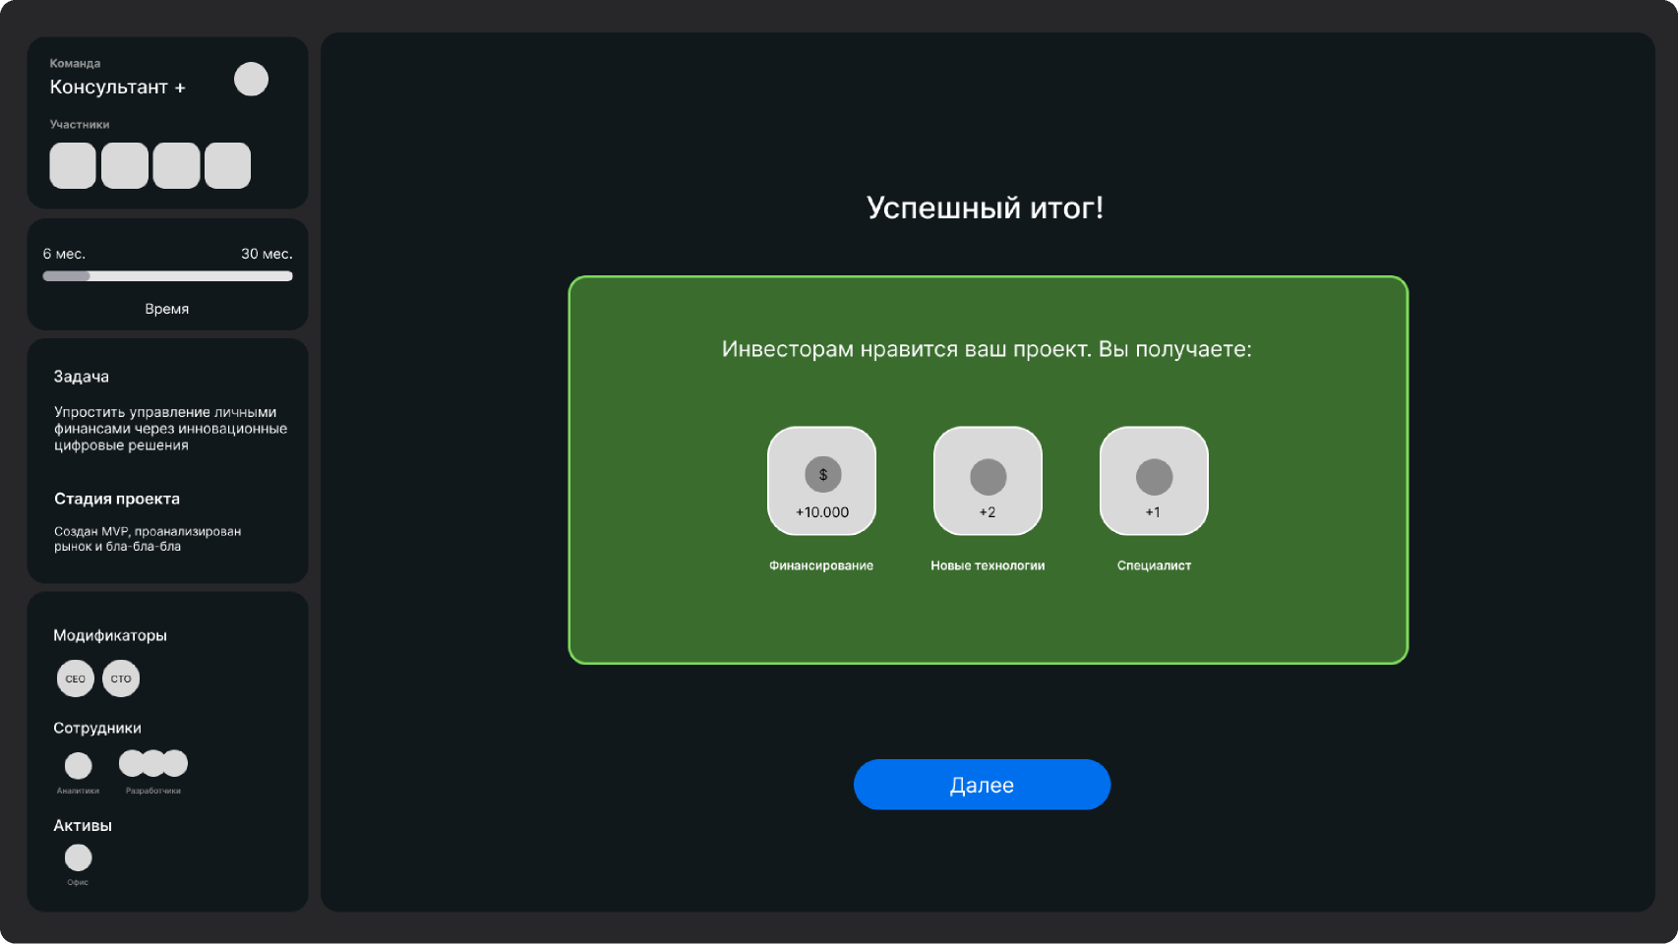
Прототипы
Защита
перед
инвесто-рами
И в случае успешного итога, предоставляет ресурсы
26/31
Notes:
well with Dev Mode, we've made it easier for developers to be involved by being in the file, developers can leave feedback on designs directly and in context designers can also use dev mode features to organize and highlight details for handoff

Slide 27

Бизнес-модель
Реализовываем
Планируем
Покупка дополнительных ресурсов/подсказок
Единовременная покупка игры
27/31
Notes:
if there's any gap in this process, it causes a lot of friction missing information can lead to a chaotic workflow and additional cycles of back and forth between design and development when I worked as a frontend engineer, one of the issues I ran into often was missing crucial details when building a feature I'd realize, sometimes after already starting work on the design, that I there were missing details like how a design should look at certain breakpoints, or how the design should behave in an edge case I needed these details to continue my work - so sometimes it meant that I was blocked on my project Other times, if I was on a particularly tight deadline, I'd make my best guess at what they intended - but that led to further thrash down the line

Slide 28
План развития
28/31
Notes:
so how can Figma help?

Slide 29
Ближайшее будущее
→
Одиночная игра против ИИ с анализом стартапа и стратегией его развития
→
Корректировка и обучение существующей LLM-модели
→
Развитие игры, как бизнес-симулятора
29/31
Notes:
one of the things we hear most often from development teams, are that designs are missing key details resulting in extra cycles this could be as minor as figuring out what's ready to build among a sea of designs and explorations or things like missing edge cases or responsive considerations

Slide 30
Долгосрочное развитие
→
Добавление кооперативной игры, и развитие формата, и развитие формата “кейс-чемпионата” против других игроков
→
Переход на более совершенные LLM модели
→
Внедрение системы доп.покупок по расширению функионала и ресурсов
30/31
Notes:
one of the things we hear most often from development teams, are that designs are missing key details resulting in extra cycles this could be as minor as figuring out what's ready to build among a sea of designs and explorations or things like missing edge cases or responsive considerations

Slide 31
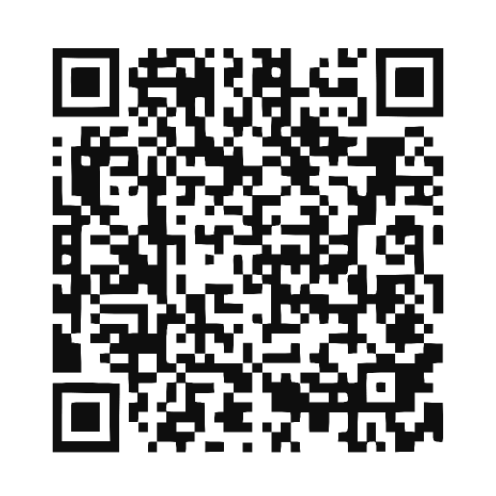
Наш репозиторий
31/31
Notes:
thank you for listening you can grab a copy of this talk and check out all the resources I mentioned via the link on the screen or by scanning the QR code I hope you're able to take some of these practices to make your designer-developer process smoother

